Slide 2
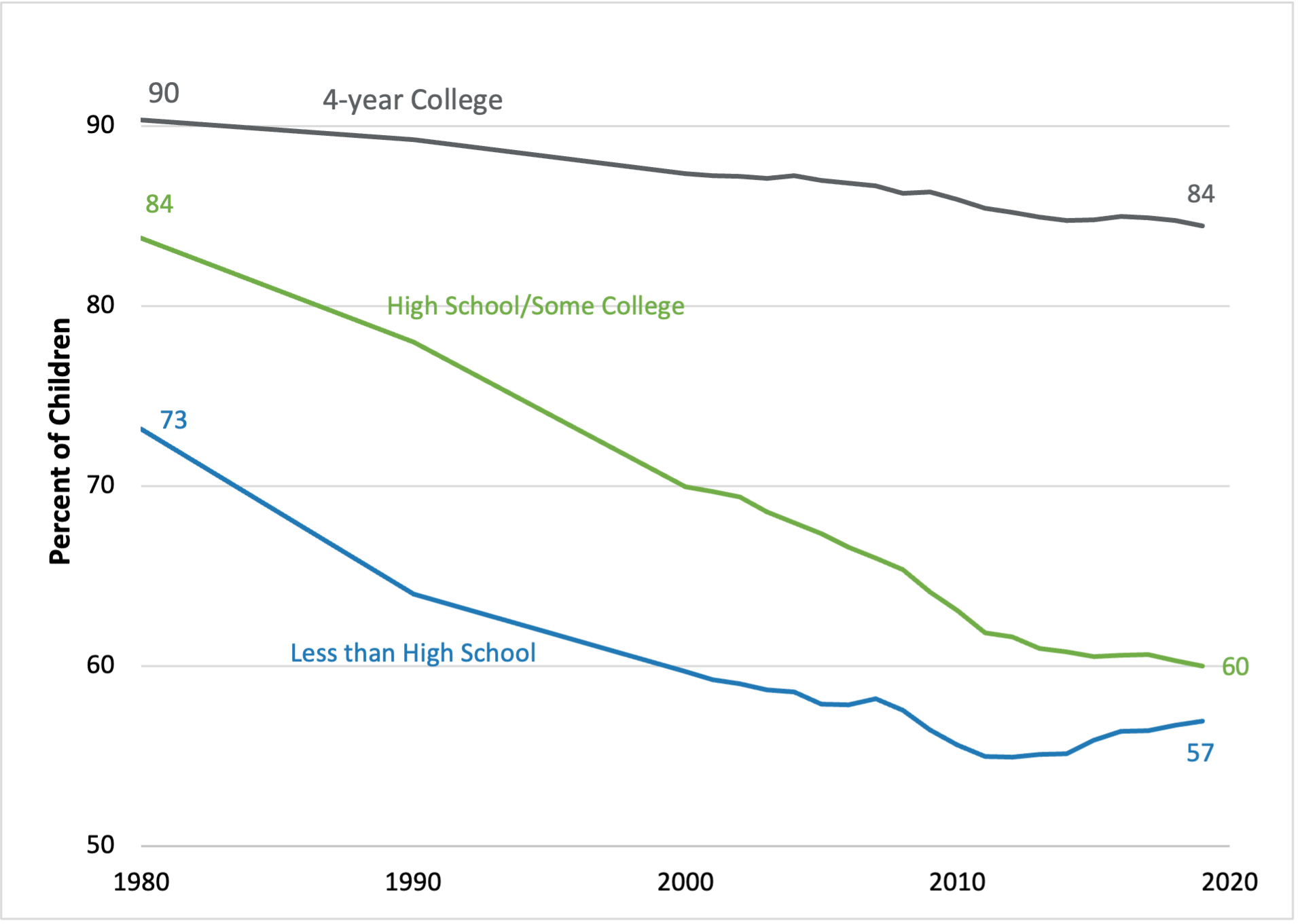
Figure 1: Percent of children living with married parents, by mother’s education
Source: Author’s calculations using 1980 and 1990 US Decennial Census and 2000-2019 US Census American Community Survey.
Note: Observations are weighted using child’s survey weight.

Slide 3
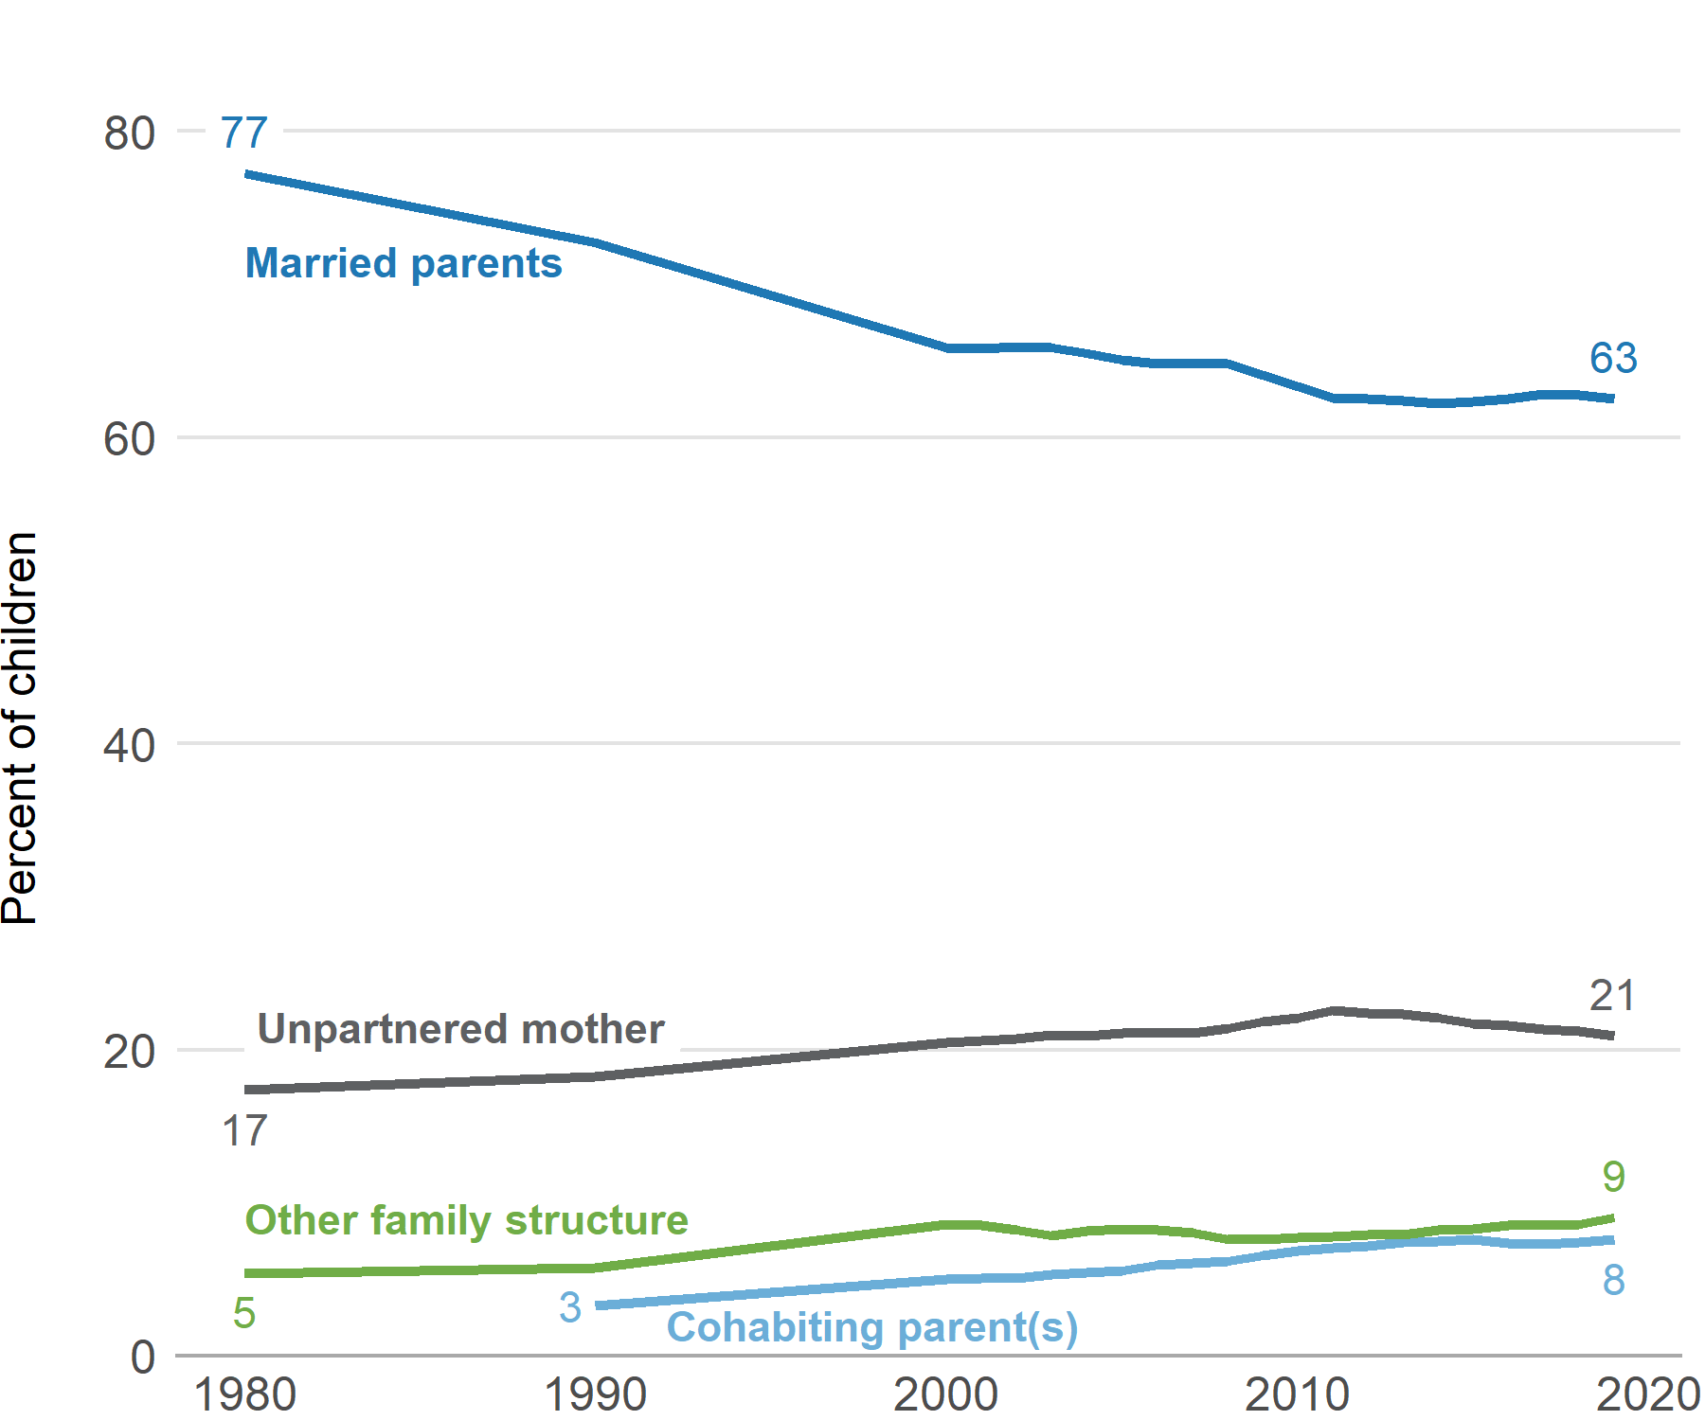
Figure 2.1: Share of children living with married parents, unpartnered mother, cohabiting parents, or in other arrangement
Source: Author’s calculations using 1980 and 1990 US Decennial Census and 2000-2019 US Census American Community Survey. Observations weighted using child’s survey weight.

Slide 4
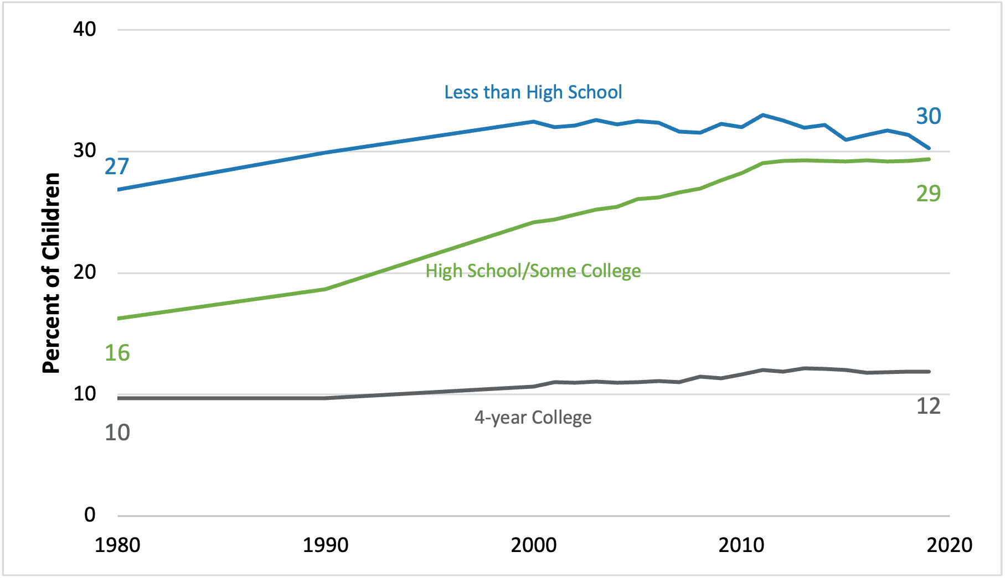
Figure 2.2: Share of children in unpartnered mother households, by maternal education
Source: Author’s calculations using 1980 and 1990 US Decennial Census and 2000-2019 US Census American Community Survey. Observations weighted using child’s survey weight.

Slide 5
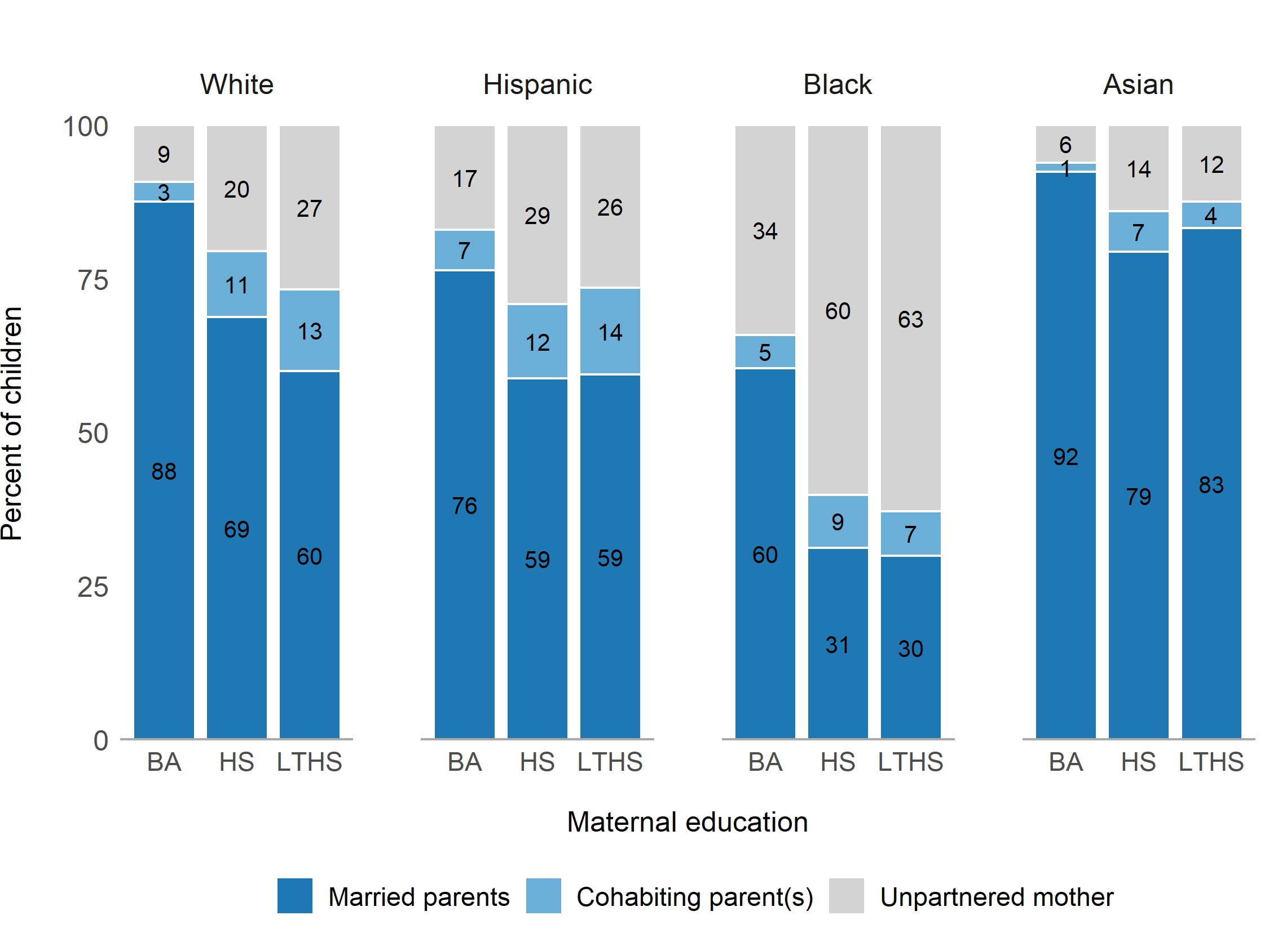
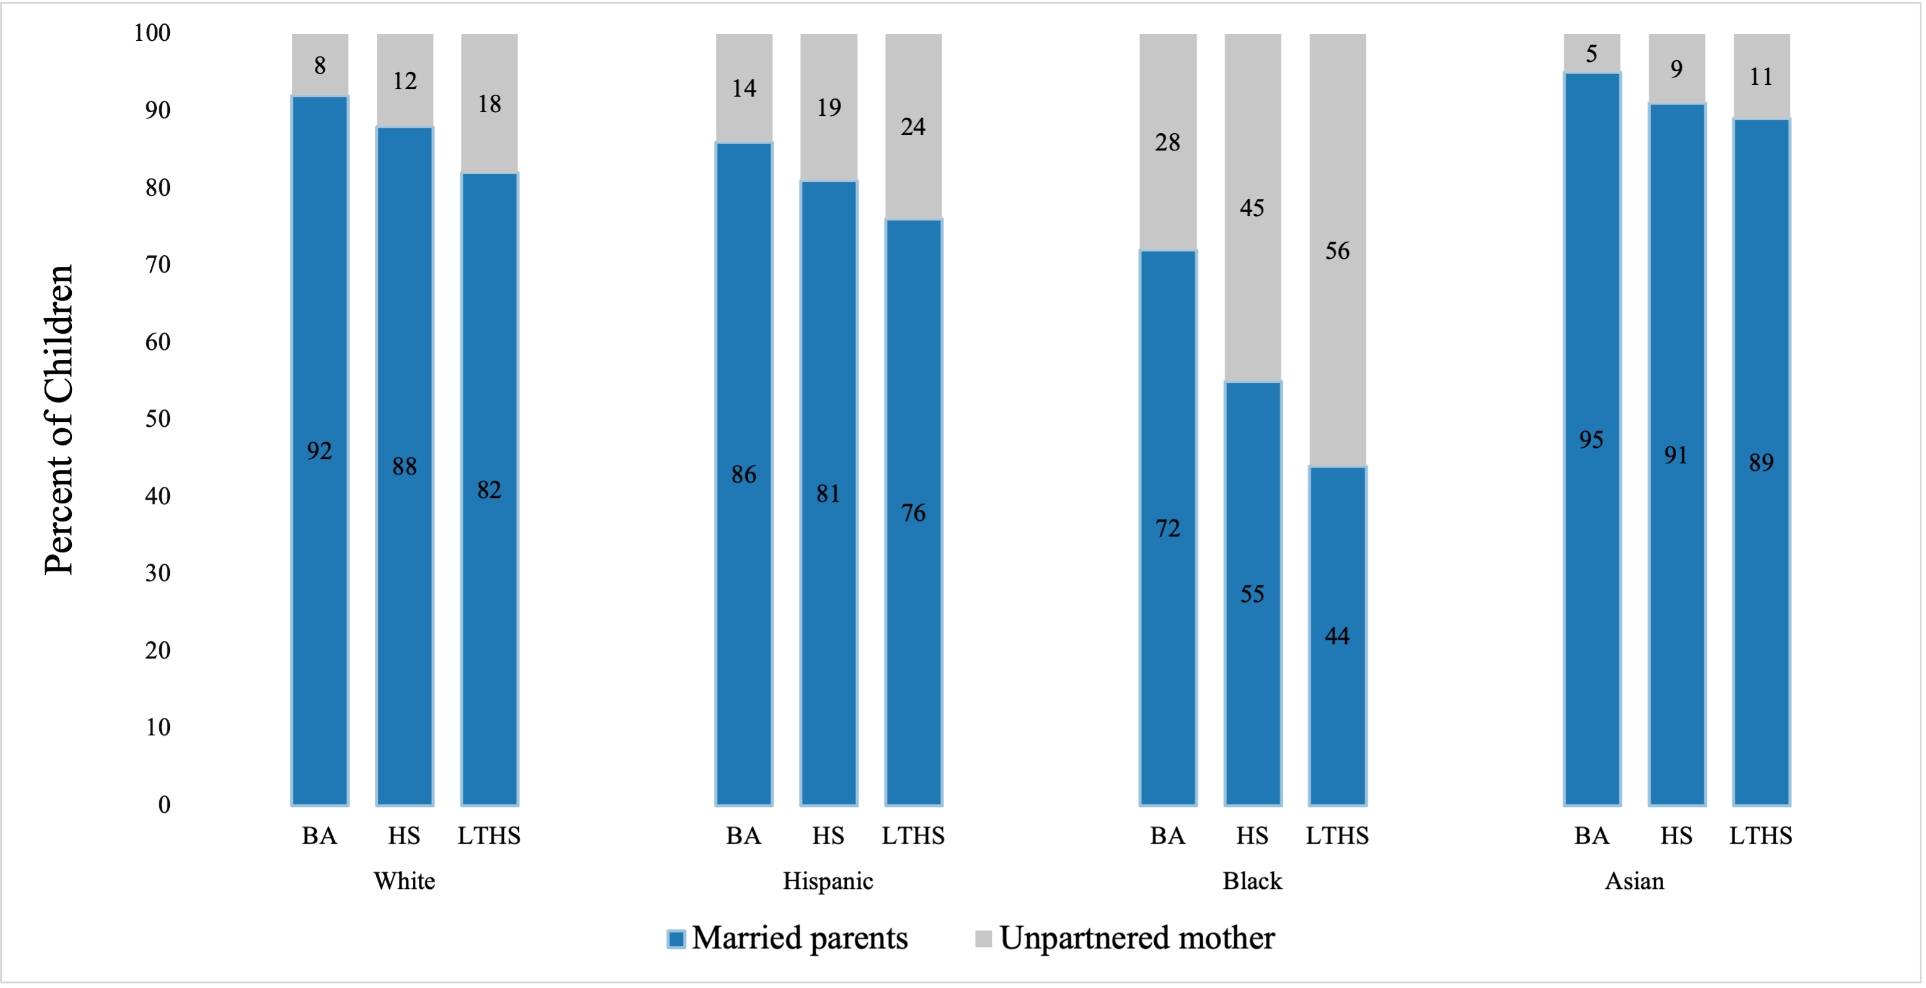
Figure 2.3: Children’s family structure, by maternal race and education: 2019 and 1980
2019
1980
Notes: Author’s calculations using 2019 US Census American Community Survey. Tabulations include all children ages 0 to 18 who live with their mother, weighted using children’s weights. Cohabiting parents cannot be identified in the 1980 Census.

Slide 6
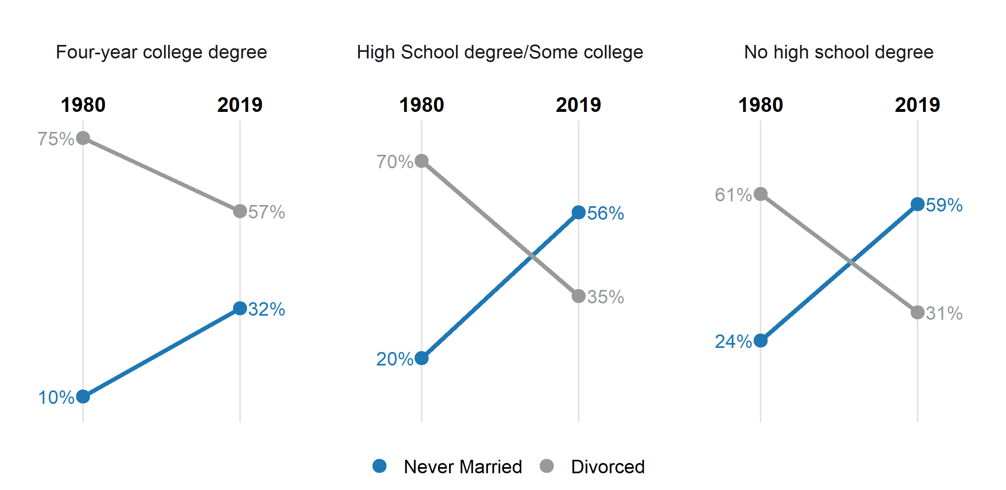
Figure 2.4: Change in marital circumstances of unpartnered mothers between 1980 and 2019, by mother’s education
Source: Author’s calculations using 1980 and 1990 US Decennial Census and 2000-2019 US Census American Community Survey. Observations are weighted using child’s survey weight.

Slide 7
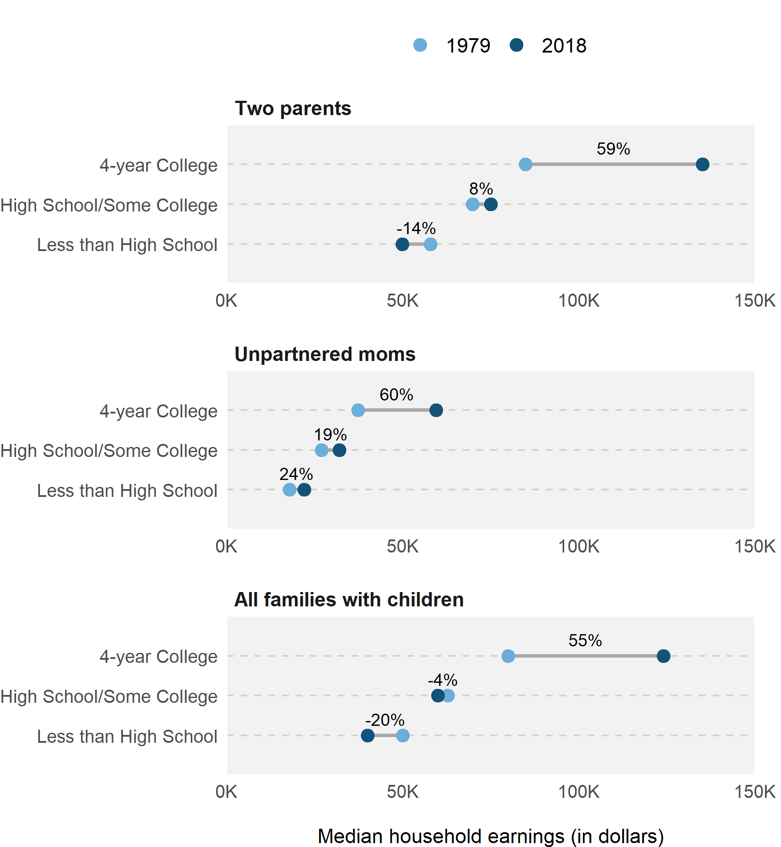
Figure 2.5: Change in median household earnings for families with children between 1980 and 2019, by maternal education level and family structure
Source: Author’s calculations using 1980 Census and 2019 American Community Survey, reflecting prior year earnings. The sample is limited to mothers with a child under age 18. There is one observation per mother, weighted by the mother’s person weight.

Slide 8
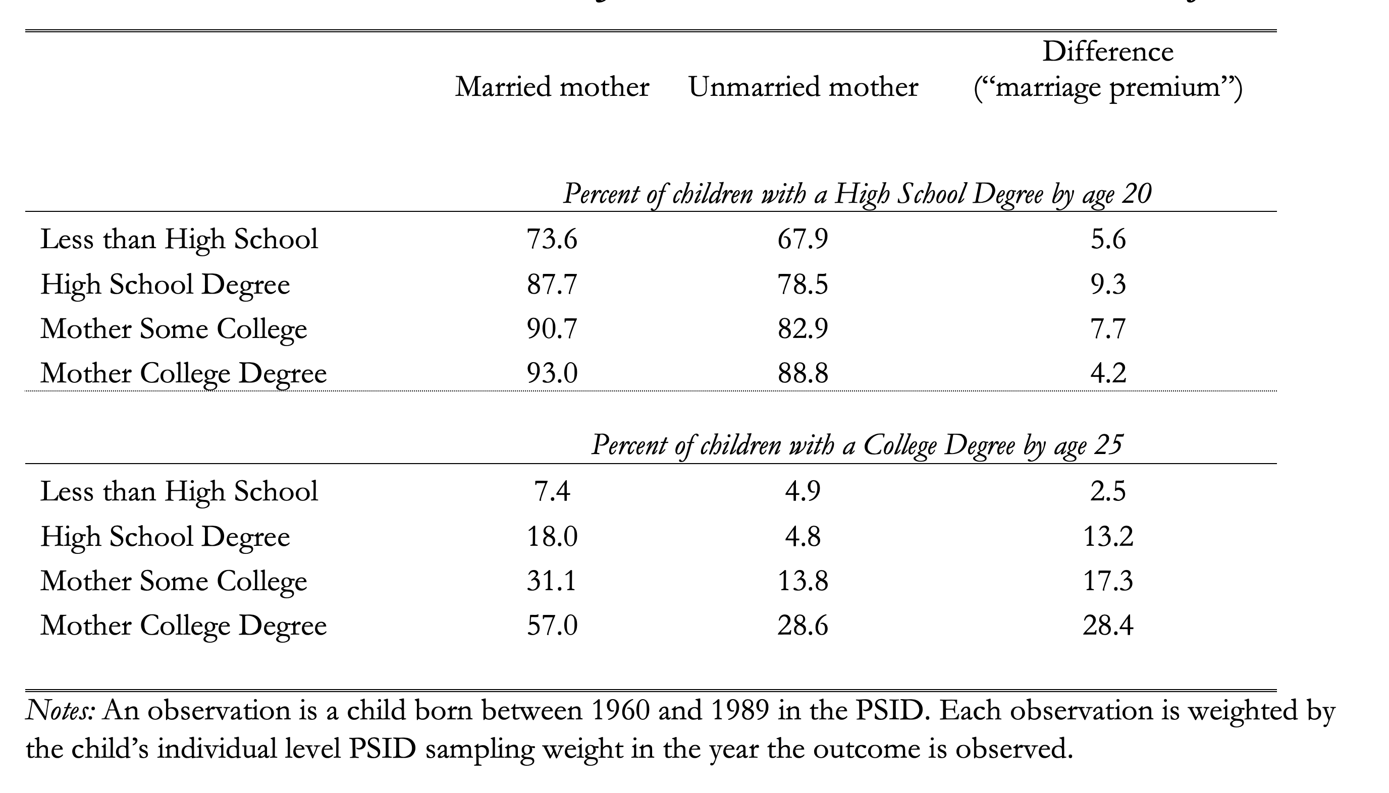
Table 3.1: Children’s educational outcomes by mother’s marital status and mother’s level of education

Slide 9
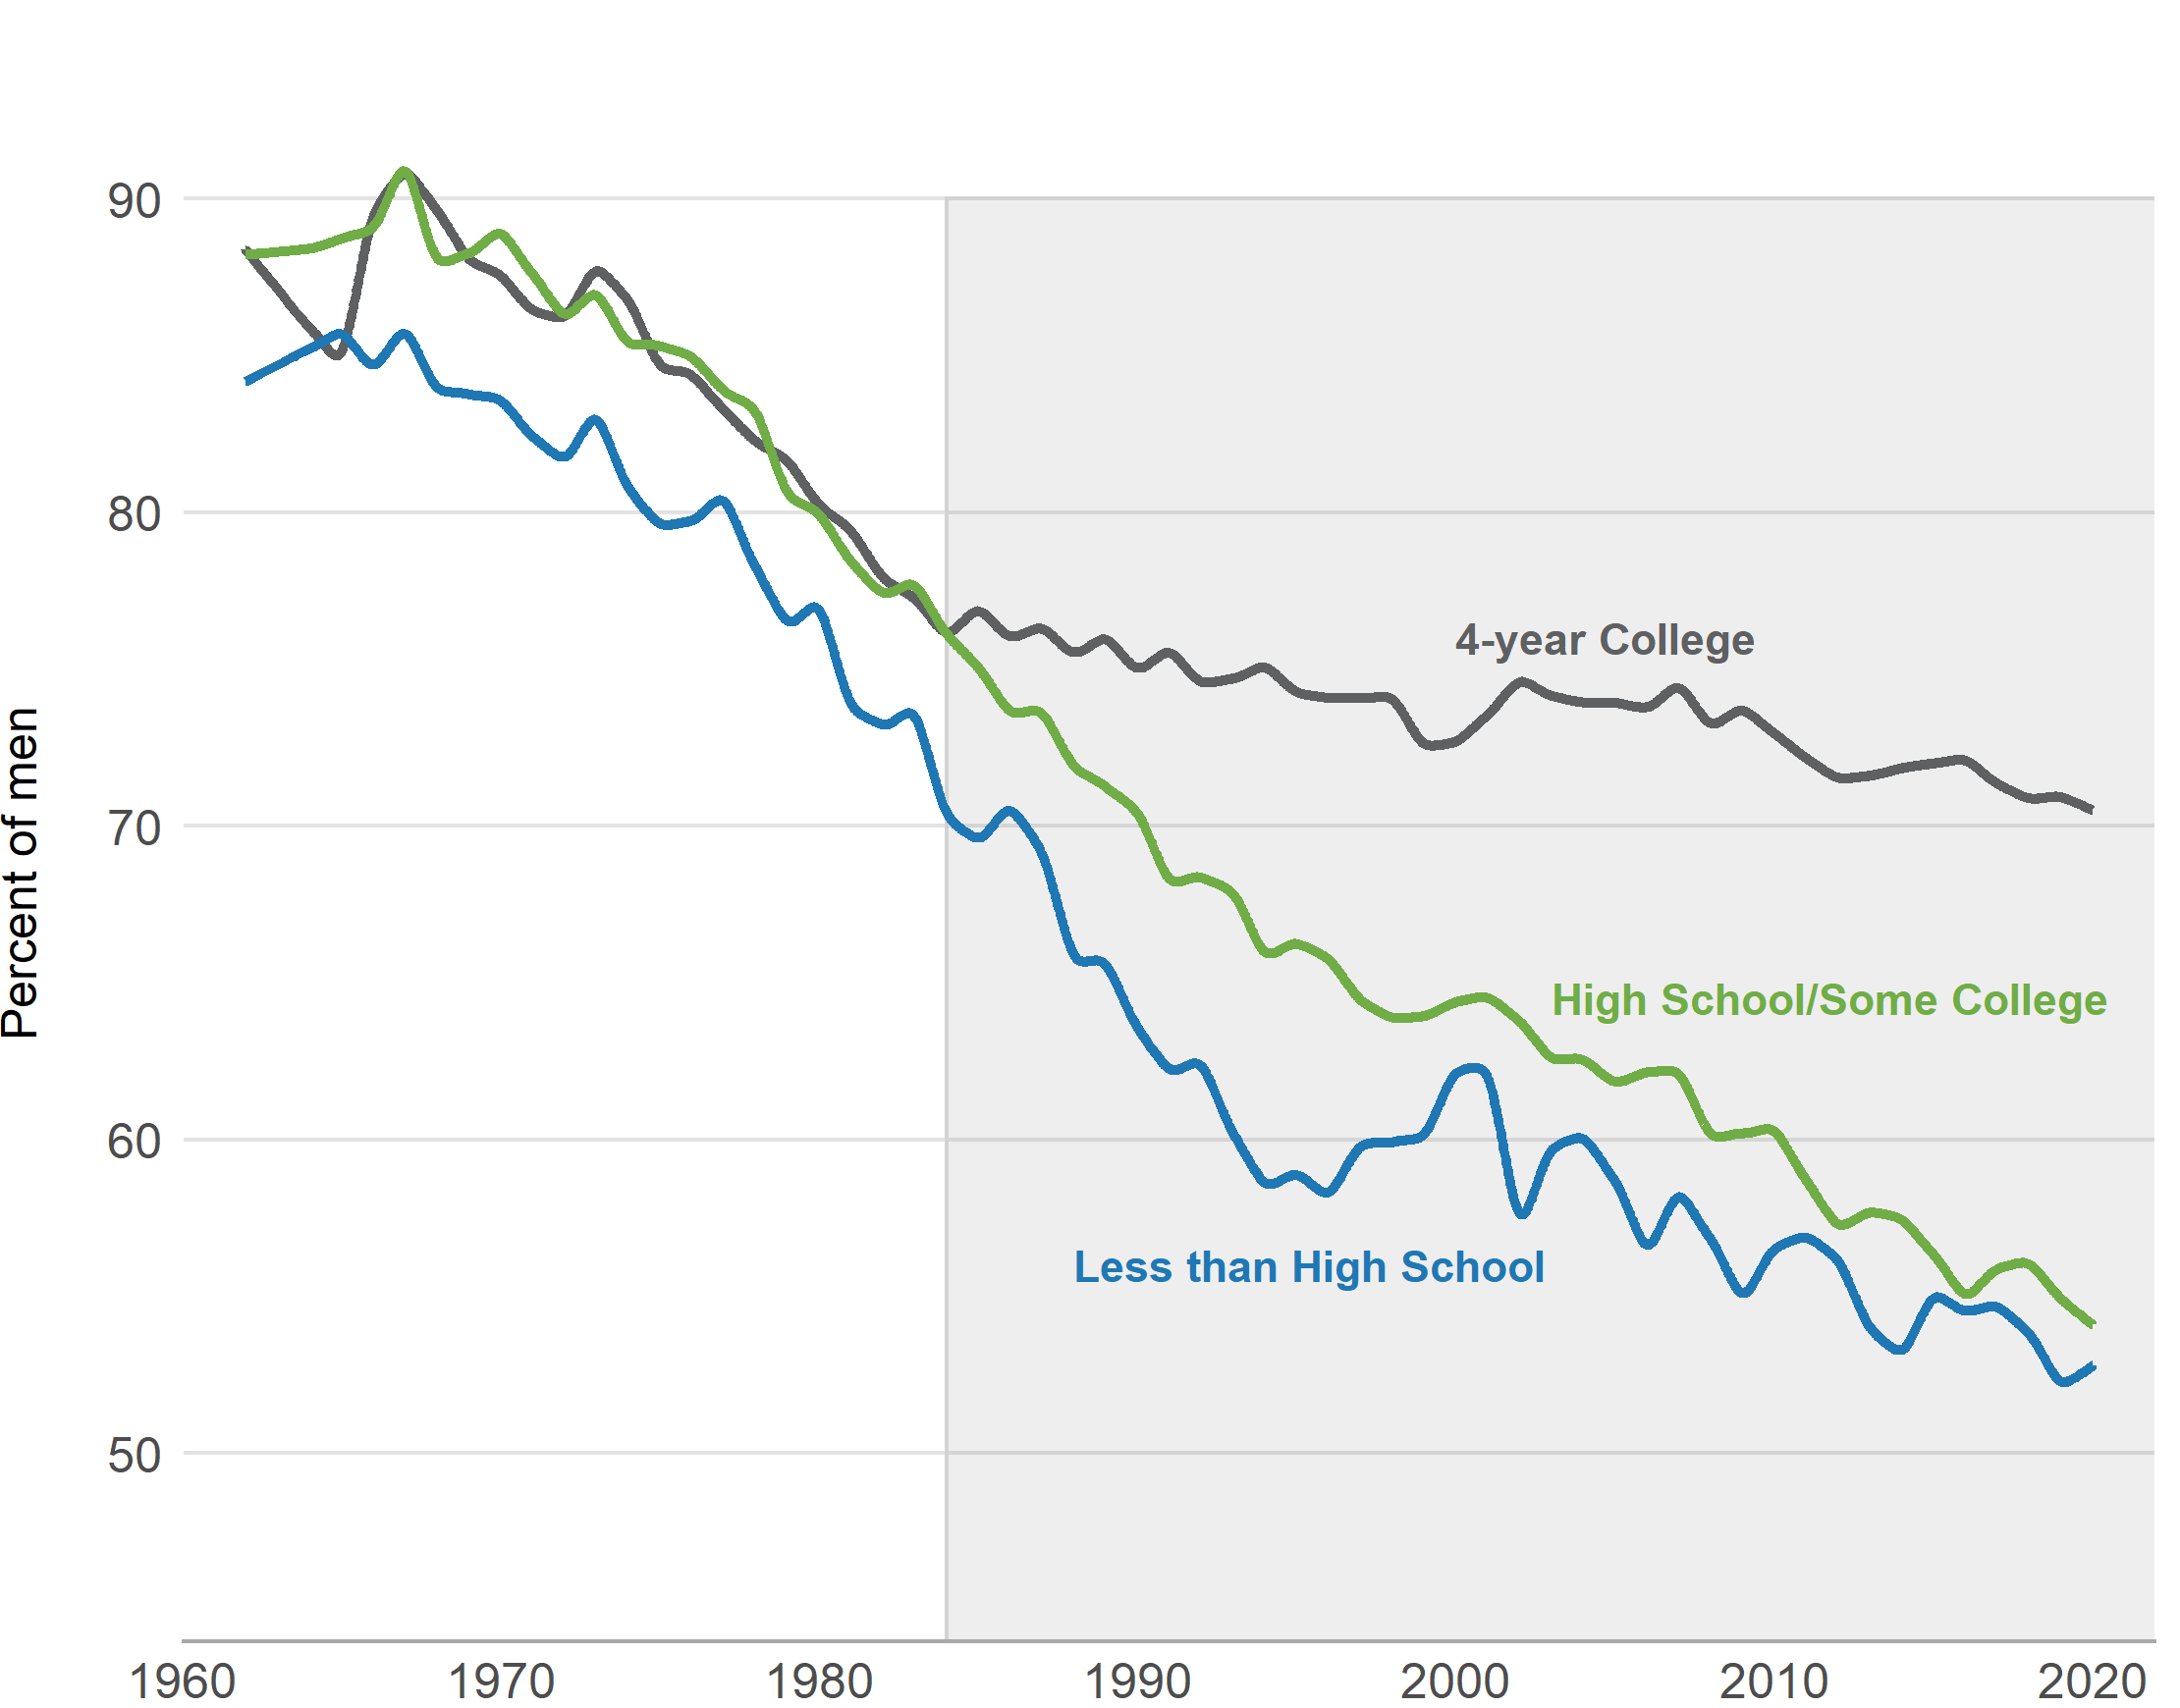
Figure 4.1: Share of men ages 30-50 married, by education level
Notes: These data are from the March Current Population Survey, 1962-2020. Sample includes noninstitutionalized males between the ages of 30 and 50, weighted using CPS person weights. In 2020, the share of men in the three education groups (less than a high school degree, high school and some college, and a 4-year college degree) were 9, 52, and 39%, respectively.

Slide 10
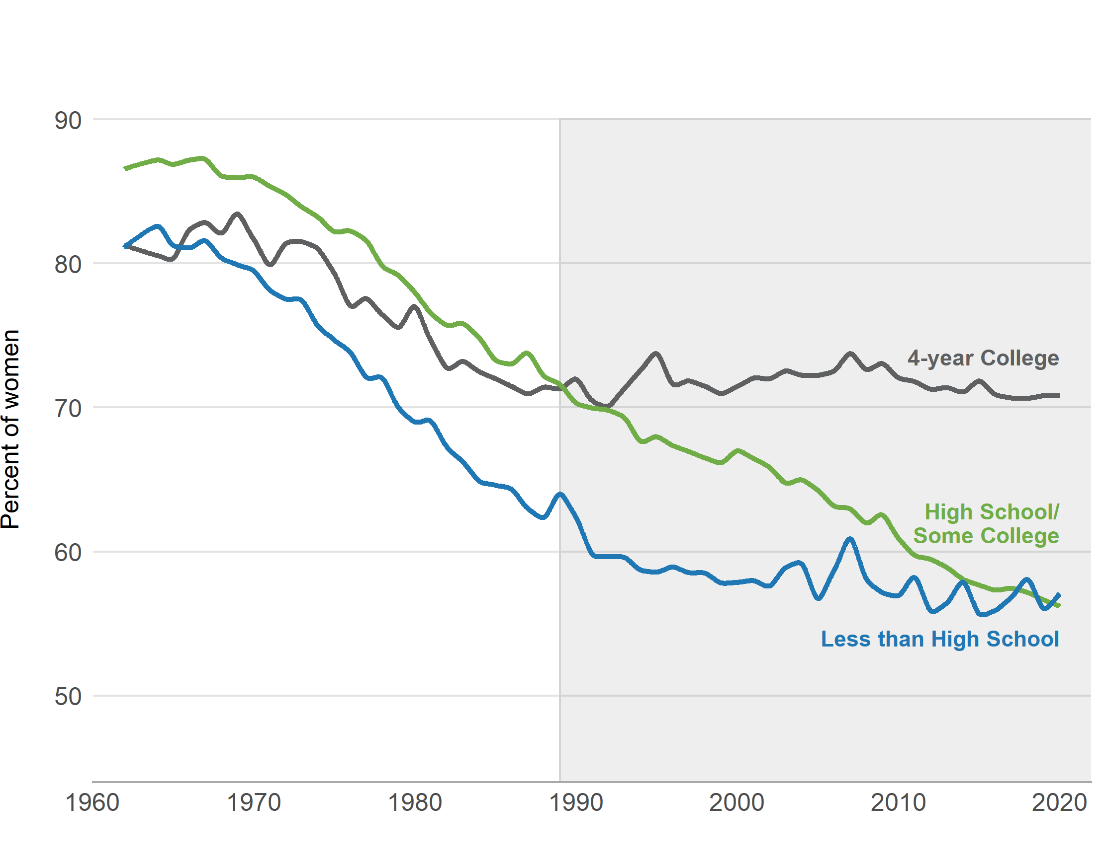
Figure 4.2: Share of women ages 30-50 married, by education level
Notes: These statistics are tabulated from the annual March Current Population Survey, 1962-2020. Sample includes noninstitutionalized females between the ages of 30 and 50, weighted using person weights. In 2020, the share of women in each of the three education groups (less than a high school degree, high school or some college, and a four-year college degree) were 7, 47, and 45%, respectively.

Slide 11
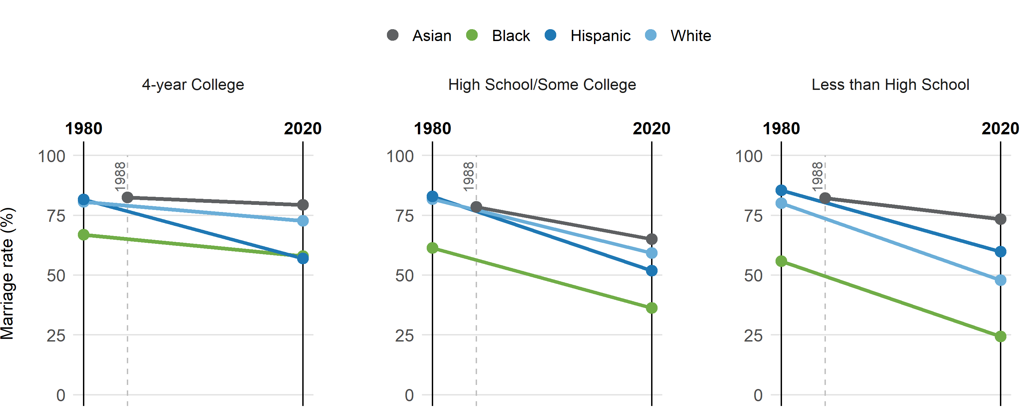
Figure 4.3: Men’s marriage rates ages 30-50, by education and race in 1980 and 2020
Note: Data is tabulated from the March Current Population Survey, 1980 and 2020 for all race/ethnic groups except Asians; marriage rates among Asians are tabulated from the 1988 instead of the 1980 CPS, which is the first year that racial category is separately recorded. Sample includes noninstitutionalized men between the ages of 30 - 50, weighted using person weights. The shares listed under each label represent the share of men in that racial/ethnic group with that level of educational attainment in 2020.

Slide 12
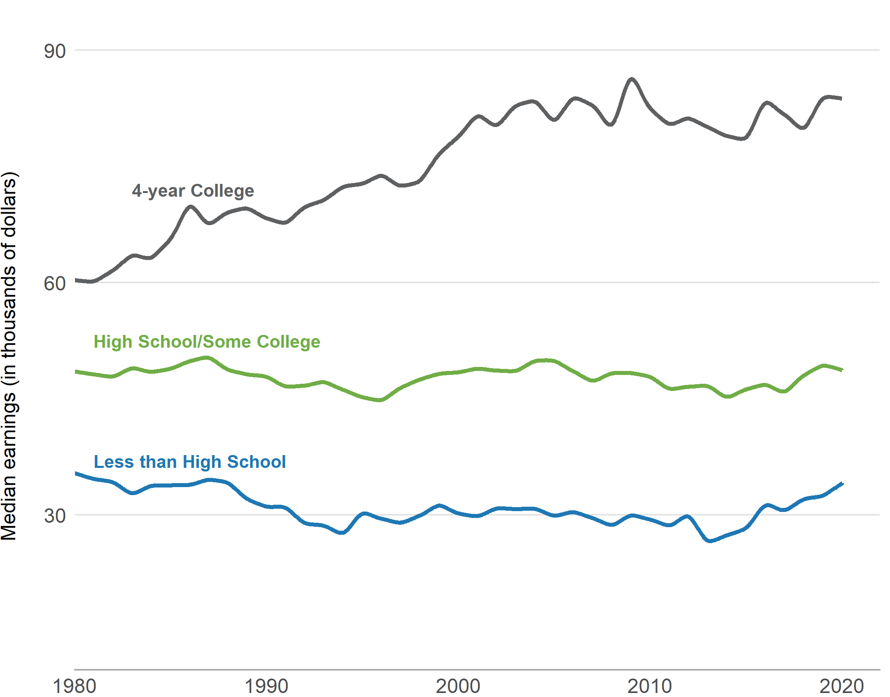
Figure 4.4: Median earnings of men ages 30-50, by educational attainment
Notes: Sample includes noninstitutionalized males between the ages of 30 – 50 who reported that they usually worked at least 35 hours and worked for at least 40 weeks in the previous year, weighted using person weights. Earnings reported in 2018 USD. Source: March Current Population Survey, 1962-2020.

Slide 13
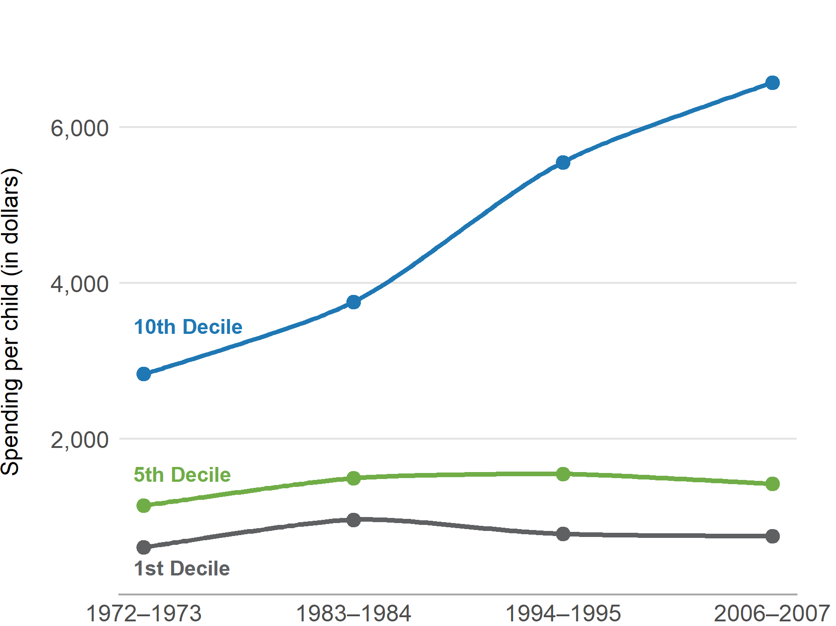
Figure 5.1: Parental spending per child by household income decile
Source: Data taken from Kornich and Furstenberg (2013), Table 3.

Slide 14
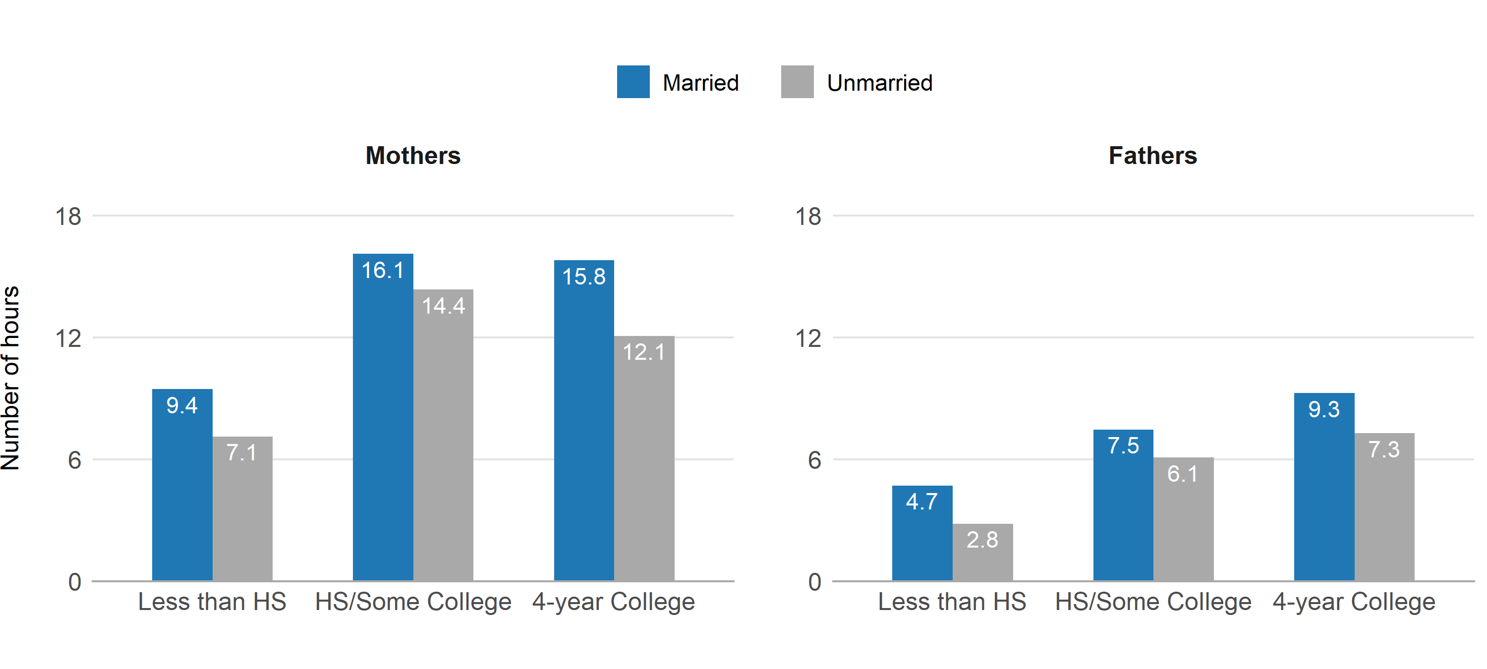
Figure 5.2: Hours per week parents spend in childcare activities, by parental education level and marital status
Source: Author’s tabulations of 2019 American Time Use Survey.

Slide 15
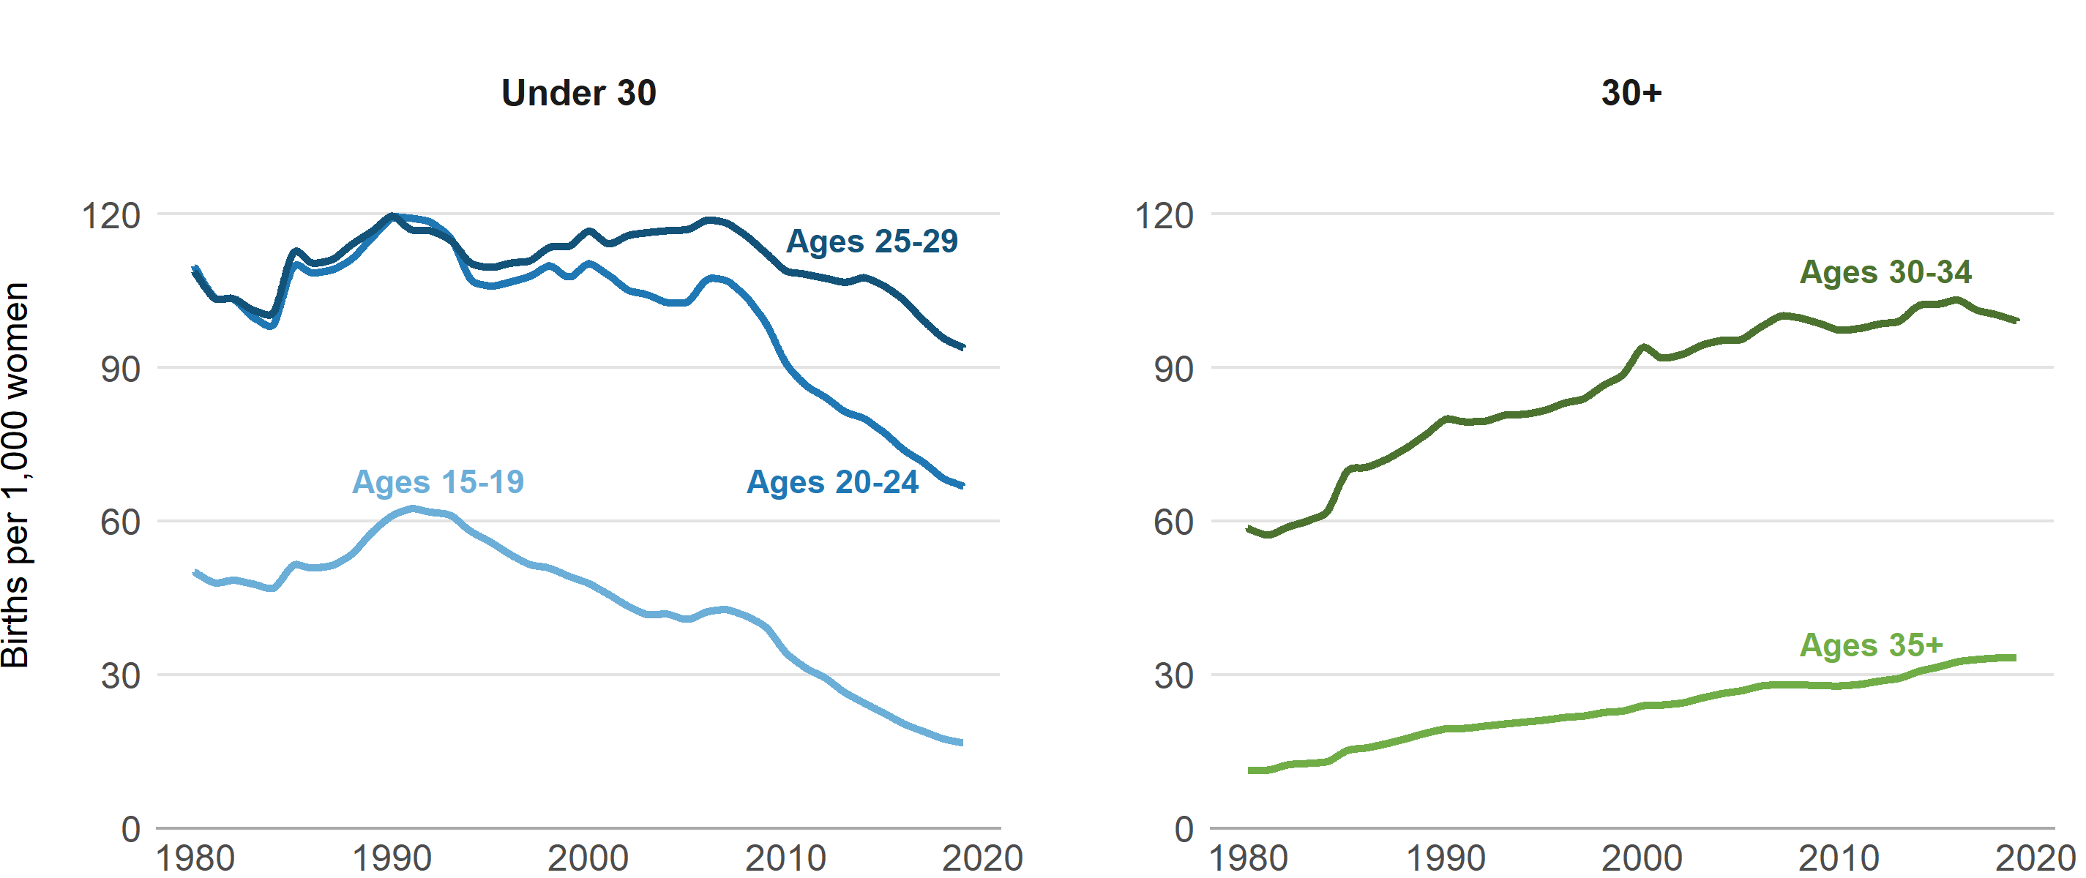
Figure 7.1: Birth rates, by five-year age group, 1980-2019
Source: Author’s calculations using 1980 – 2019 Natality Data from the National Center for Health Statistics and the Current Population Survey.

Slide 16
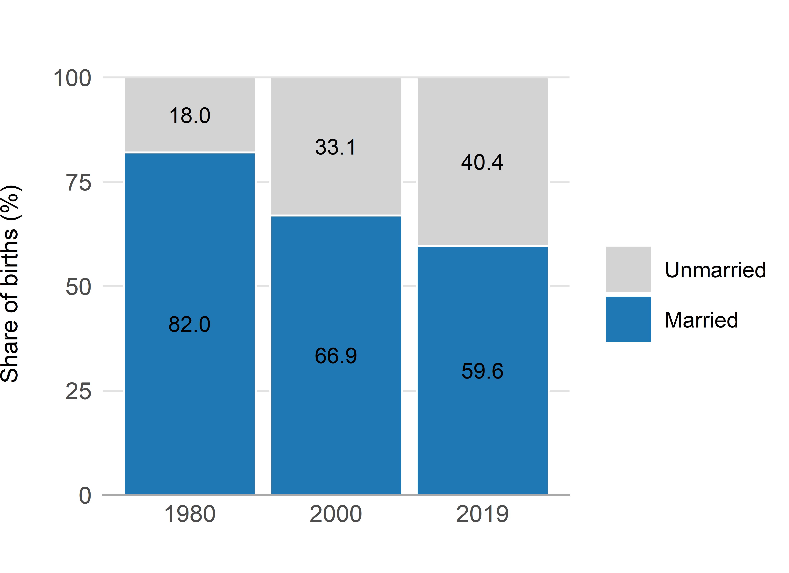
Figure 7.2: Share of births in 1980, 2000, 2019 to unmarried and married mothers
Source: Author’s calculations using 1980, 2000, and 2019 Natality Data from the National Center for Health Statistics.

Slide 17
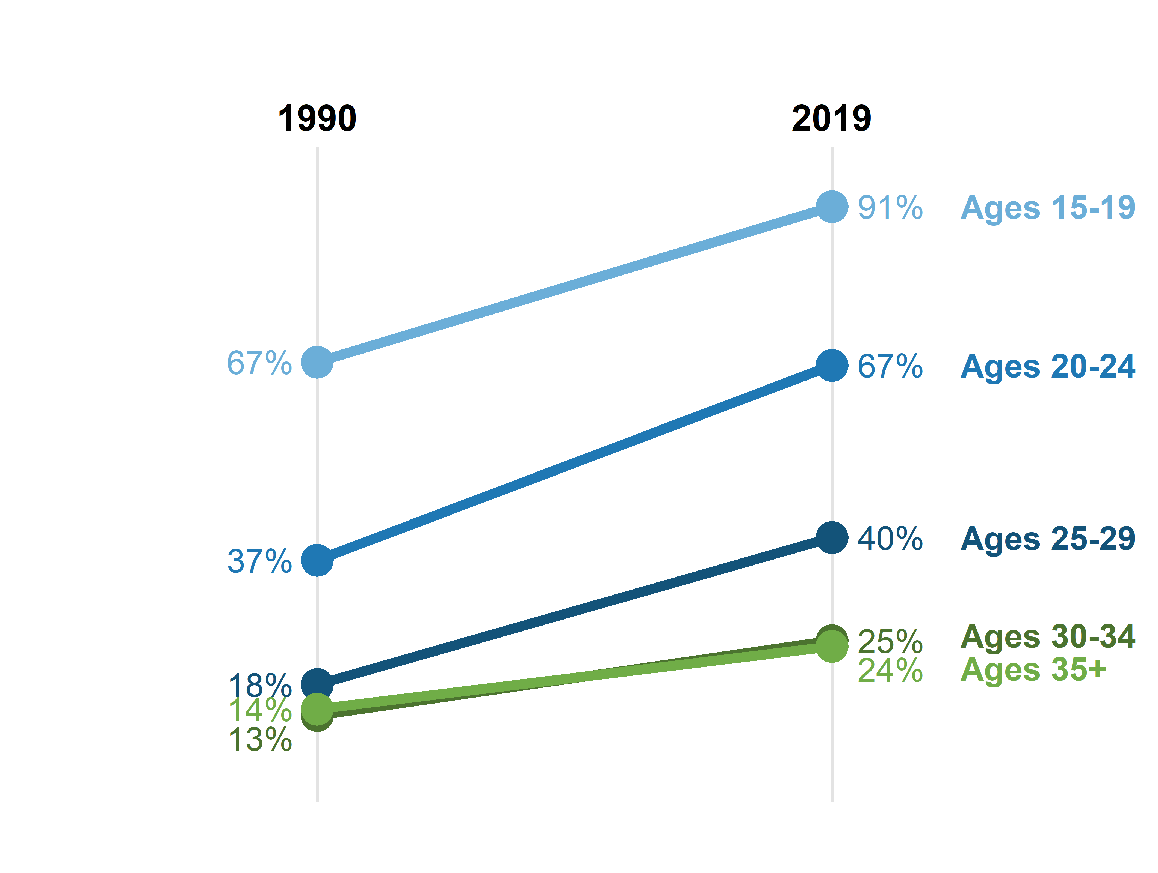
Figure 7.3 (a): Share of births to unmarried women, by age
Source: Author’s calculations using 1980 – 2019 Natality Data from the National Center for Health Statistics and the Current Population Survey.

Slide 18
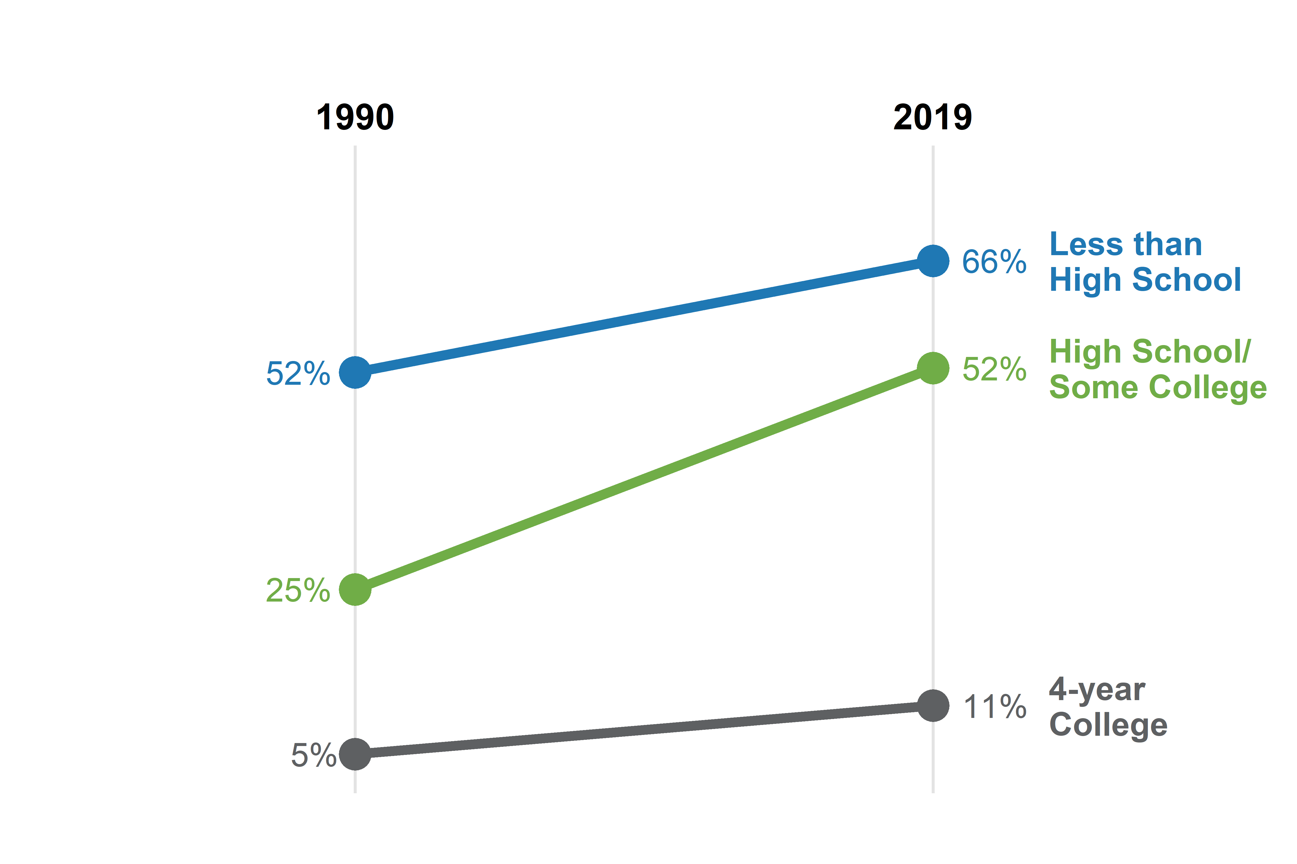
Figure 7.3 (b): Share of births to unmarried women, by education level
Source: Author’s calculations using 1980 – 2019 Natality Data from the National Center for Health Statistics and the Current Population Survey.

Slide 19
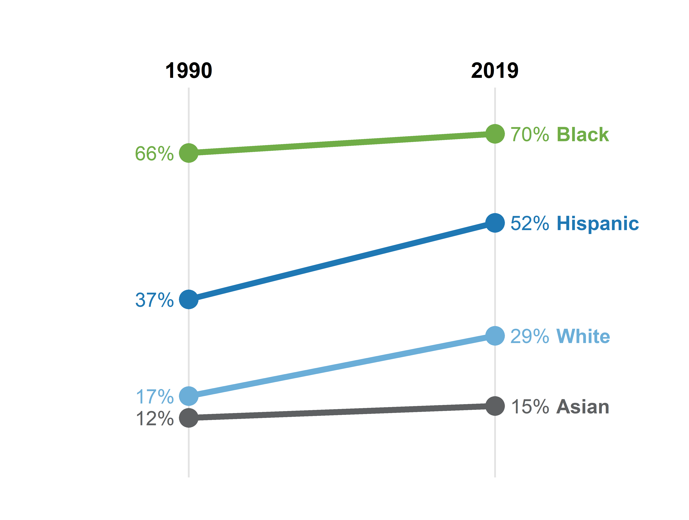
Figure 7.3 (c): Share of births to unmarried women, by race/ethnicity
Source: Author’s calculations using 1980 – 2019 Natality Data from the National Center for Health Statistics and the Current Population Survey.

